Slide 1
P369357 Automated EC change for CL module calibration tasks
Bamboo build failure and fix sharing
RLKM
Update: 01-10-2018, ACE

Slide 2
Content
Problem and Goal
Bamboo build failure reproducing and its mechanism
Learn learnt

Slide 3
Problem and Goal

Slide 4
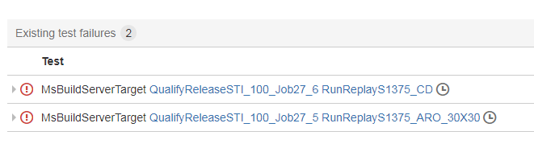
Problem and Goal
Problem
After delivering code change, the bamboo build failed and STI team ask us to solve it
Goal
Fix the bamboo build failure so STI team could merge the pull request into SP18 release

Slide 5
Bamboo build failure reproducing and its mechanism

Slide 6
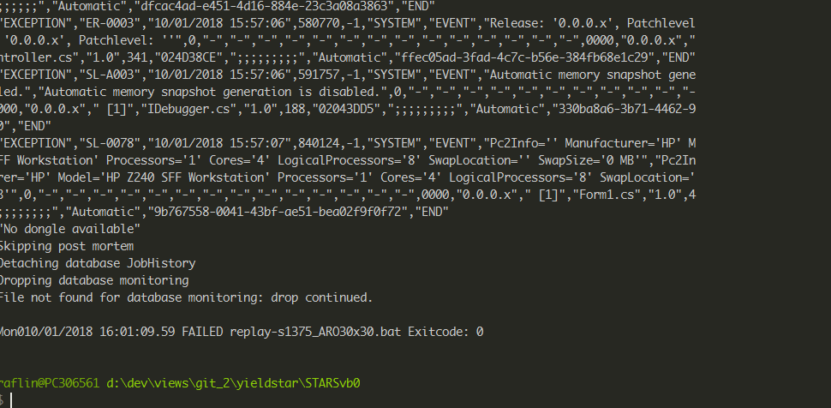
Bamboo build failure reproducing and its mechanism
Bamboo build failure
STI team ask us to run it locally to reproduce the issue
1) BuildOnly.bat
2) replay-s1375_ARO30x30.bat
Dale helps to find out the cause of the error message
Lack the ipy.exe so it can’t run python locally
1) BuildOnly.bat
2) CopyThirdPartyBinaries.bat
3) replay-s1375_ARO30x30.bat
The error shown both in target branch and SP18 release, so we doubted there’s a problem in the SP18 itself. In Ace Bamboo server, both branches failed for Job27

Slide 7
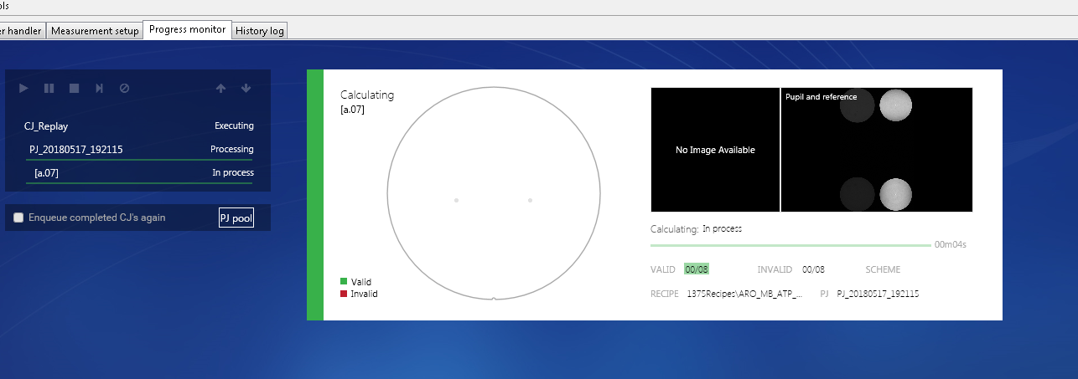
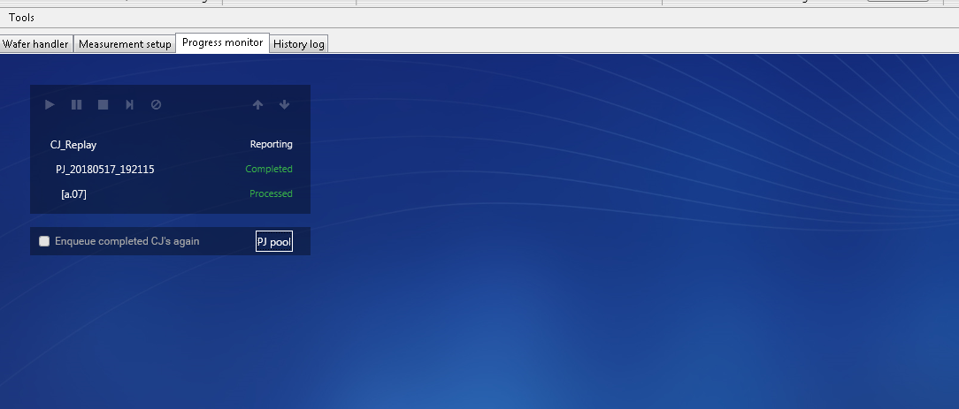
Bamboo build failure reproducing and its mechanism
If replayDataS1375_ARO30x30.bat run successfully :
In the lot operation page, it shows the measurement process.
After measurement, it is ready to output replay_output.xml for comparison

Slide 8
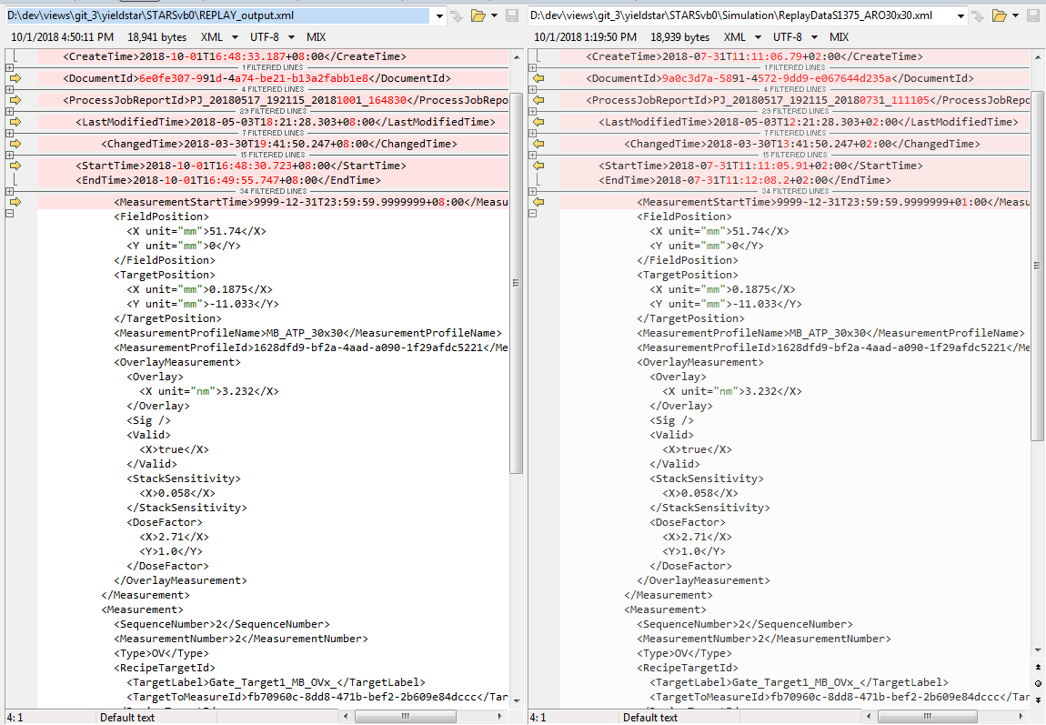
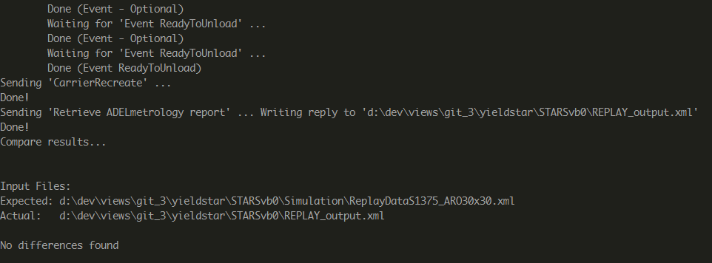
Bamboo build failure reproducing and its mechanism
Comparison between replay_output.xml and ReplayDataS1375_ARO30x30.xml
No Differences found means it runs successfully.

Slide 9
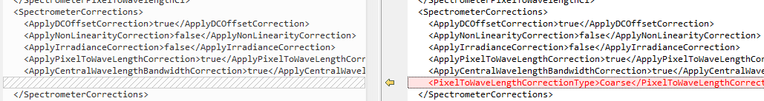
Bamboo build failure reproducing and its mechanism
The root cause : EC table is not complete
In the code change, the default value of PixelToWaveLengthCorrectionType is set to fine for YS1375 machine. But when it set as fine, Another EC entry is needed to be filled. If it’s empty, it cause the SW exception when running replay-s1375_aro30x30.bat

Slide 10
Lesson Learnt

Slide 11
Lesson Learnt
Thanks for the helps from Benny, Yalin and Dale to teach me how to reproduce this problem and debugging.
Lesson Learnt
1) The behind mechanism of bamboo build process
2) The necessary precondition before running replay-s1375_aro30x30.bat
3) The process of debugging Bamboo build failure.
4) Ace Bamboo server is not stable with respect to test result.

